Slide 1
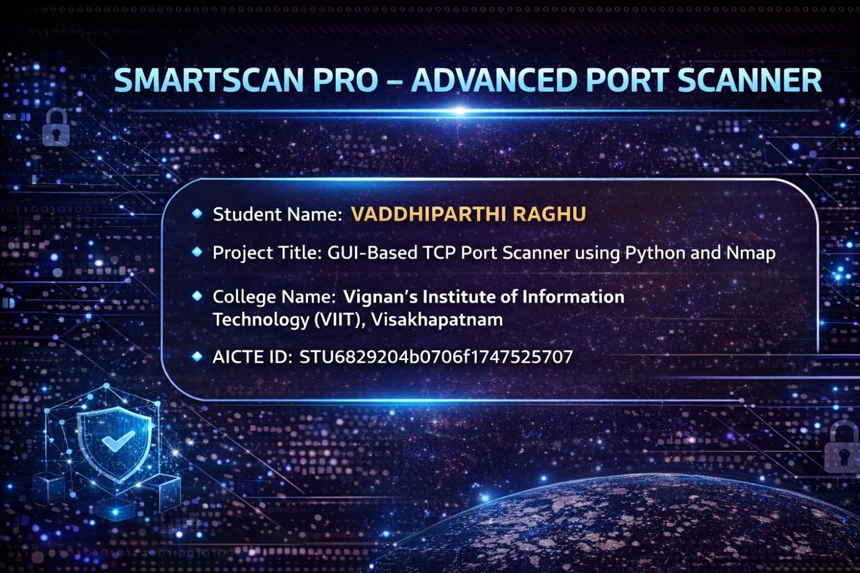

Slide 2
PROBLEM STATEMENT
In today's digital world, network security is a major concern.
Many systems have open ports that can be exploited
by attackers.
Identifying open ports manually is difficult and time-consuming.
Lack of simple tools for beginners to understand port scanning.
Need for an automated and user-friendly solution for port scanning.

Slide 3
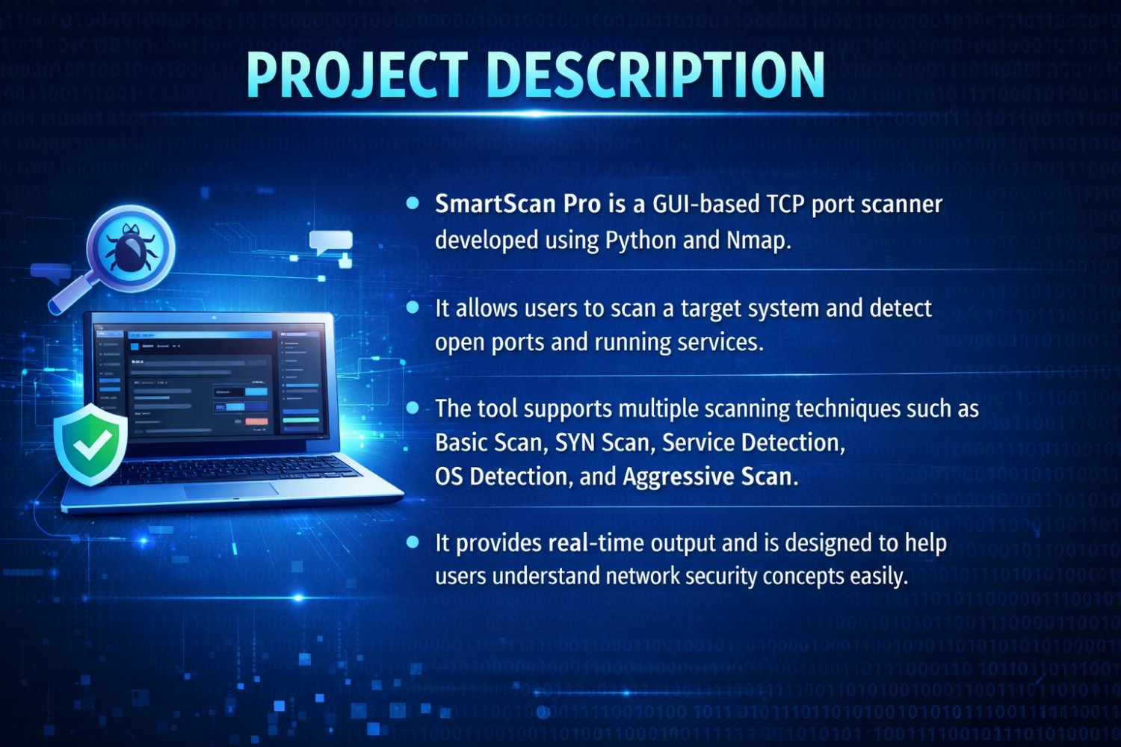

Slide 4


Slide 5
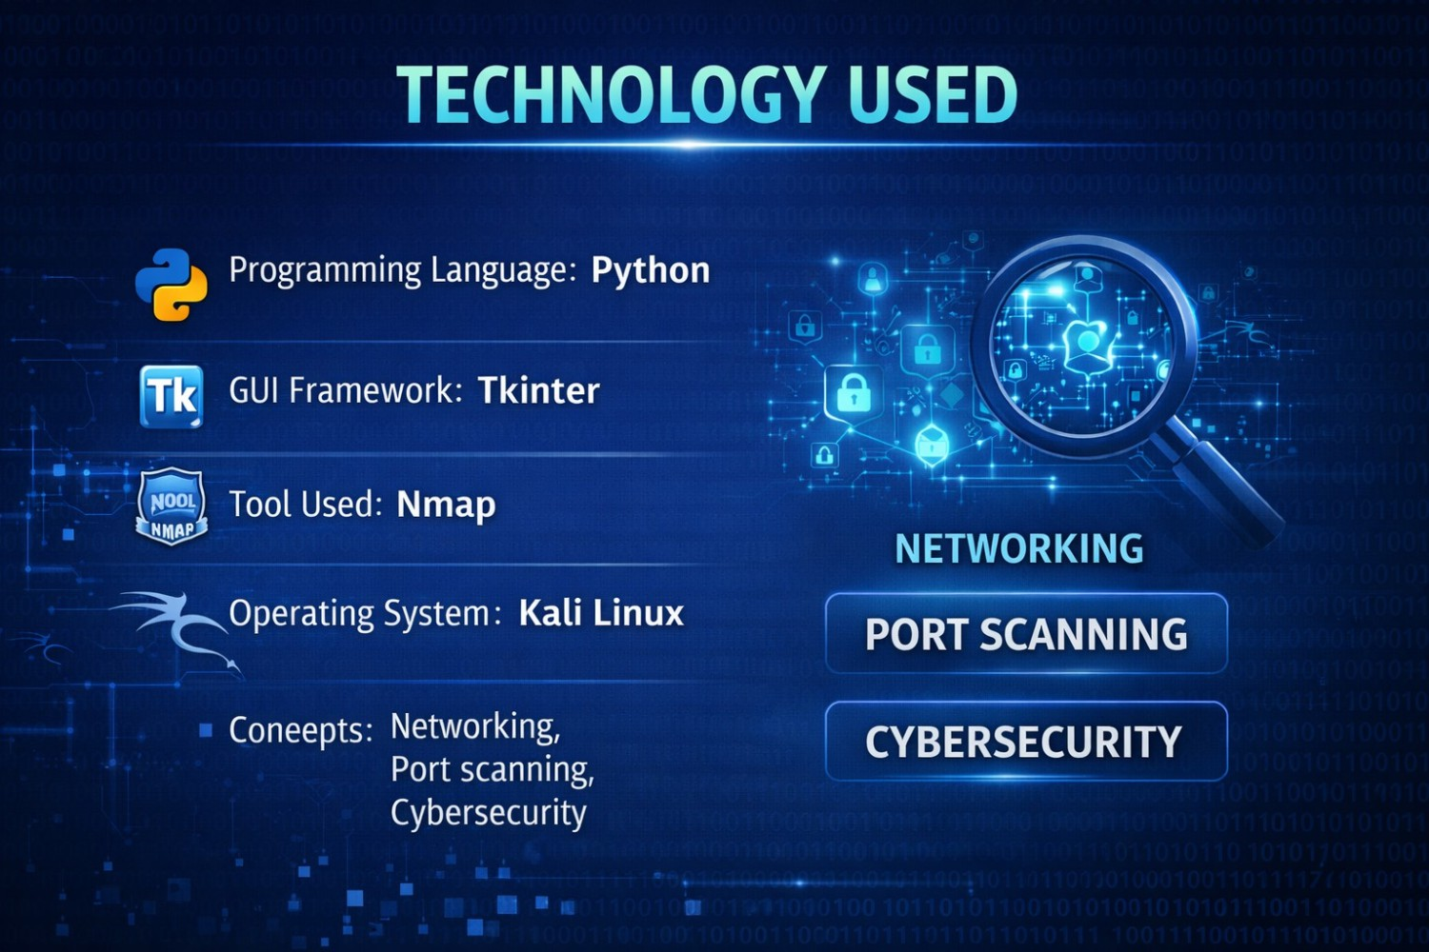

Slide 6
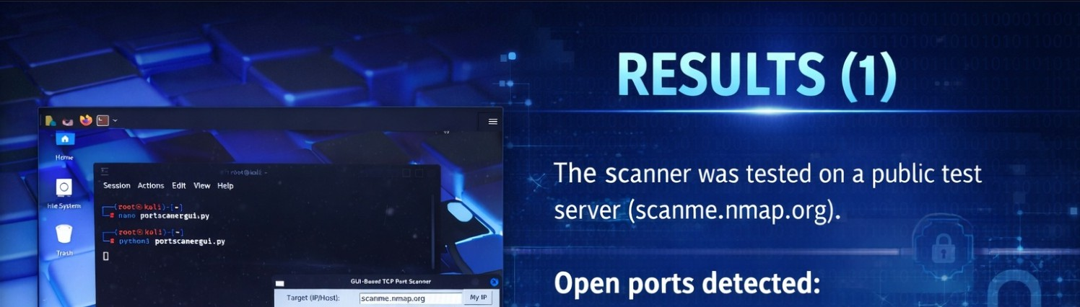

Slalt Port
End P,)rt:
l
-
1024
Stan sun I
Sc�nnlng: sconae.nnnp.org
Ports: 1·1024
IOt'!HIPort 21 (SSH) (Ot'!k) Port88(HTTP!)

Slide 7
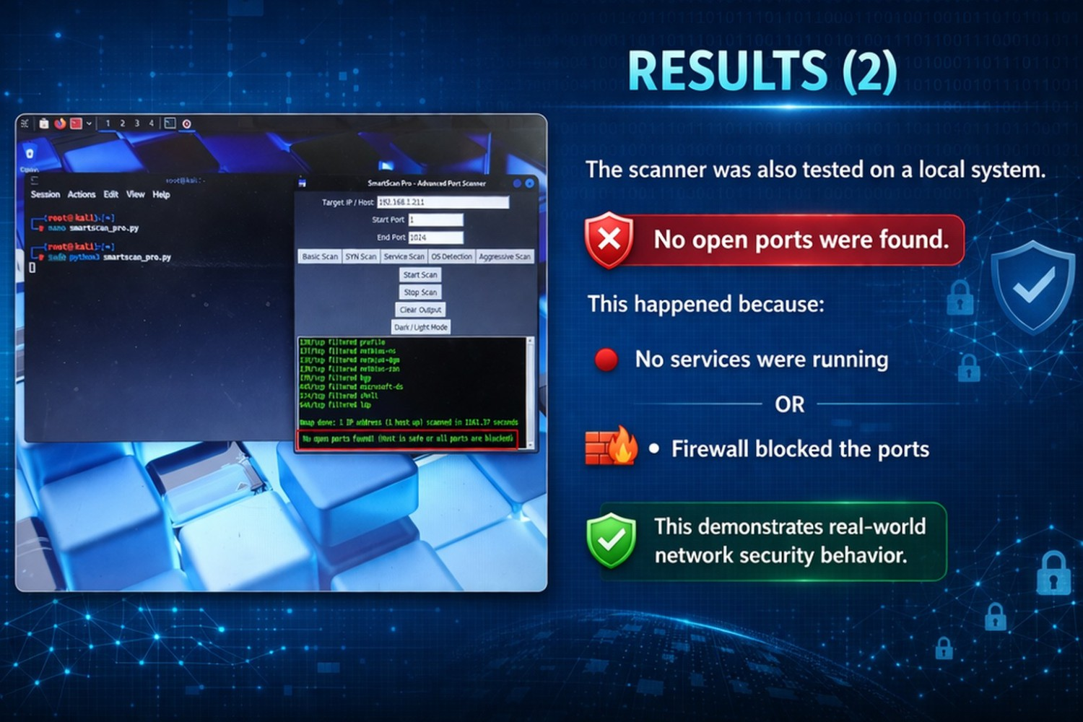

Slide 8


VOIS
Certificate of Completion
Presented to
VADDHIPARTHI RAGHU
VOIS
Vodafone Ida Foondatlon
VodafonekluFound:alion
Certificate of Completion
Presented to
VADDHIPARTHI RAGHU
For the successful completion of
Introduction to System Security
Issued on March 19, 2026
ID:VFLMS26_1487T7
For the successful completion of
Protection from Browser Attacks
Issued on March 19, 2026
ID:VFLMS26_148777

Slide 9
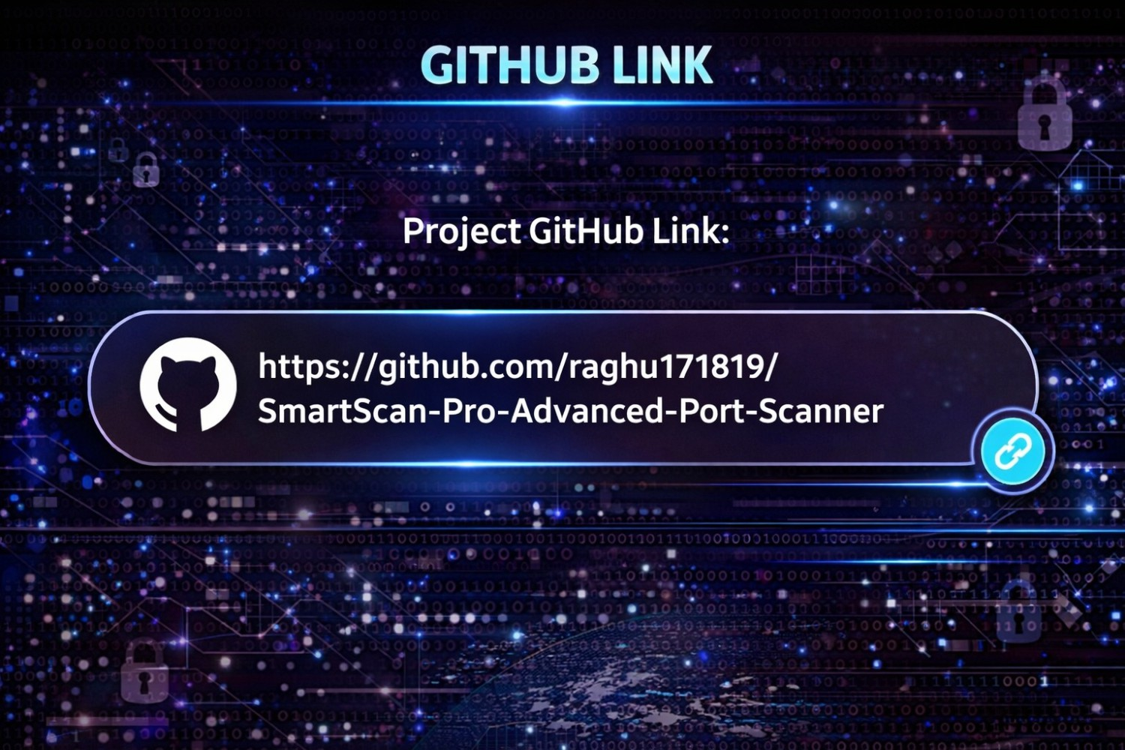

Slide 10


